Slide 1
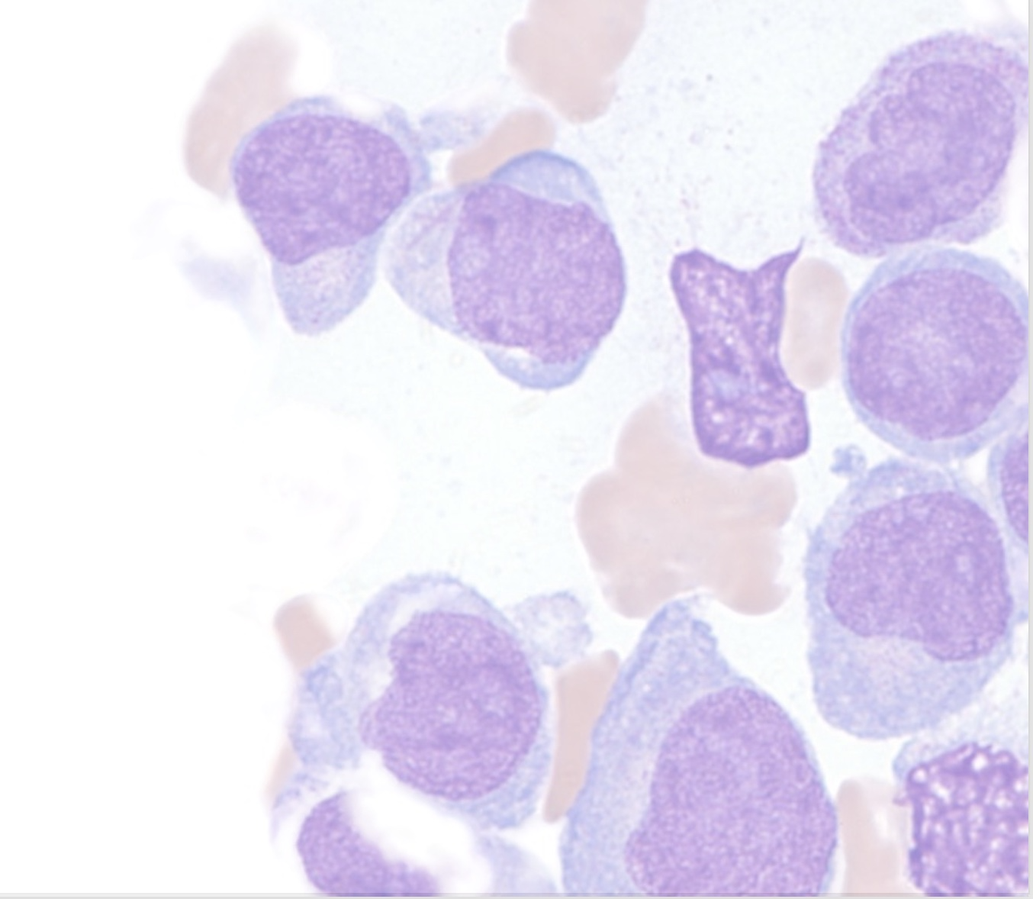
The Changing Landscape of Hematological Malignancy Treatment
Implications for antifungal therapy
Russell E. Lewis, Pharm.D., FCCP Associate Professor of Medicine, Infectious Diseases Department of Medical and Surgical Sciences Infectious Diseases Unit- IRCCS S. Orsola University Hospitals Alma Mater Studiorum Università di Bologna Bologna, Italy
May 17, 2022

Slide 2
Agenda
How will new therapies for hematological malignancies impact the epidemiology of invasive fungal infections?
What are the risks of toxicity and drug interactions with these newer therapies?
Is their a unique role for isavuconazole vs. other triazoles?

Slide 3
The cure of leukemia through the optimist’s prism
Disease | Current/future therapies* | Survival (5 year)
Hairy cell leukemia | Cladarabine + gemtuzumab ozogamicin (GO) | 90%
Acute premyelocytic leukemia | ATRA + arsenic ± GO | 80-90%
AML (core binding factor positive) | FLAG-GO ± IDA, alloHSCT if MRD positive, if indicated, oral AZA/HMA with venetoclax or FLT3/IDH or menin inhibitors | 80-90%+
AML (younger fit) | FLAG-IDA and venetoclax, CLIA and venetoclax | 50-60%

Slide 4
(H. Kantarjian et al. 2021; H. M. Kantarjian et al. 2022)
*some therapies investigational or not licensed in Canada

Slide 5
Disease | Current/ future therapy* | 5-10 year survival
AML (older, unfit, complex karyotype, T-53 mutations, MECOM) | Low-intensity triple nucleosides (cladarabine, cytarabine and HMAs + venetoclax; HMAs + venetoclax + targeted therapy | 40-50%
ALL < 60 years | HyperCVAD + CD19/CD20 targeted antibodies | 60-70%
ALL > 60 years | Mini-hyper CVAD+ inotuzumab; blinatumab + ponatinib | 50%
Ph-positive ALL | HyperCVAD + ponatinib; blinatumab + ponatinib | 70-80%?

Slide 6
(H. Kantarjian et al. 2021; H. M. Kantarjian et al. 2022)
*some therapies investigational or not licensed in Canada

Slide 7
Disease | Current/ future therapy* | 5-10 year survival
CML | BCR-Abl1 tyrosine kinase inhibitors (imatinib, dasatinib, bosutinib, nilotunib, ponatinib), alloHSCT | 85-90%
CLL | Ibrutinib, other BTKIs (acalabrutinib, zanubrutinib, pirtobrutinib) | 80-90% +
MDS | Parenteral HMAs, oral HMAs, venetoclax, others | 40% +

Slide 8
(H. Kantarjian et al. 2021)
*some therapies investigational or not licensed in Canada

Slide 9
How is invasive fungal disease risk altered by targeted therapies?

Slide 10
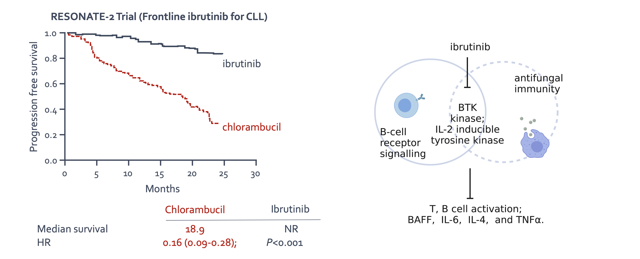
Unexpected consequences of targeted therapy?

Slide 11
(Burger et al. 2015; Chamilos, Lionakis, and Kontoyiannis 2018)

Slide 12
Ibrutinib-associated aspergillosis
Retrospective French surveillance study identified 33 cases of aspergillosis in ibrutinib-treated patients with CLL
CNS aspergillosis in 11/27 (40%), most cases within 3 months of starting therapy
All patients had refractory/relapsed CLL and other predisposing risk factors

Slide 13
(Ghez et al. 2018; Chamilos, Lionakis, and Kontoyiannis 2018)

Slide 14
Fungal infections in patients receiving ibrutinib for lymphoid cancers
Data from MSKCC, New York
In a second, retrospective study from MDACC (2014-2018):
21 (2.5%) with proven/probable invasive mold infection
Primarily pneumonia
Primary fungus: Aspergillus spp.
Risk factors: monocytopenia, ≥ 3 prior CLL therapies

Slide 15
(Varughese et al. 2018; Frei et al. 2020)

Slide 16
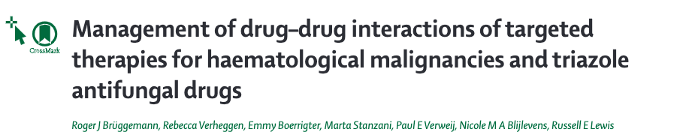

Slide 17
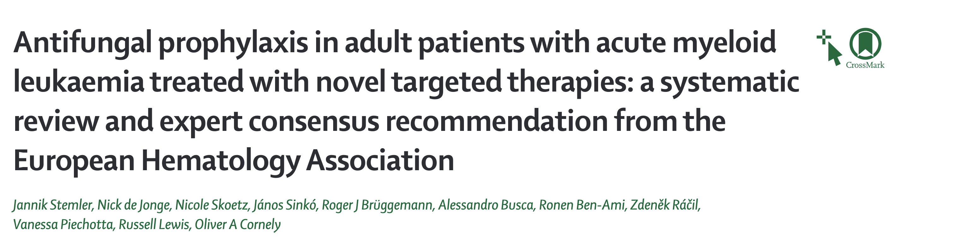

Slide 18
(R. J. Brüggemann et al. 2022; Stemler et al. 2022)

Slide 19
Managing fungal infection risks with novel therapies for AML
EHA consensus recommendations
Systematic review of the literature, recommendations developed using GRADE framework (4977 publications evaluated)
Outcomes evaluated:
Incidence of invasive fungal disease (IFD)
Prolongation of hospitalization
Days spent in ICU/mortality associated with IFD
Potential DDIs
Evidence-based recommendations were developed for hypomethylating agents (HMAs), midostaurin, venetoclax-HMA combinations
(Stemler et al. 2022)

Slide 20
Summary of EHA recommendations-1
Hypomethylating agent monotherapy:
Standard use or prophylaxis not recommended
Risk of IFI increased in patients with neutropenia at onset of treatment, prior intensive chemotherapy → conditional recommendation for prophylaxis
FLT3 inhibitors (midostaurin, gilteritinib)
Antifungal prophylaxis recommended during induction chemotherapy
Conditional recommendation for prophylaxis during consolidation in patients with risk factors (prior IFI, prolonged neutropenia)
Lack of clear medical guidance for managing drug interactions
Close monitoring favoured over empiric FLT-3 inhibitor dose reduction
(Stemler et al. 2022)

Slide 21
Summary of EHA recommendations-2
Venetoclax
Risk of IFI increased in patients with neutropenia at onset of treatment, prior intensive chemotherapy, or prolonged neutropenia with venetoclax
Conditional recommendation to administer prophylaxis
Careful management of drug interactions with triazoles
(Stemler et al. 2022)

Slide 22
Venetoclax dose-adjustment with triazoles
Day | Full dose | Moderate¹ CYP3A4 inhibitor | Strong² CYP3A4 inhibitor
Day 1 | 100 mg | 50 mg | 10 mg
Day 2 | 200 mg | 100 mg | 20 mg
Day 3 | 400 mg | 200 mg | 50 mg
Day 4-28 | 400 mg | 200 mg | 70 mg
Venetoclax + hypo-methylating agents for AML;
Co-administration with posaconazole ↑ venetoclax AUC 8-fold

Slide 23
(Stemler et al. 2022; Bhatnagar et al. 2021)

Slide 24
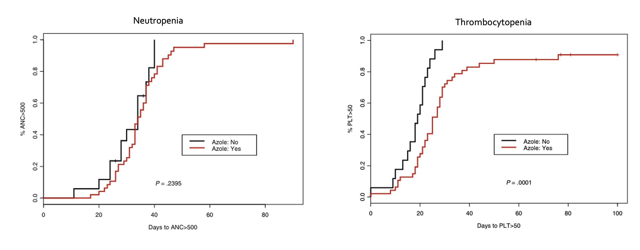
Triazole prophylaxis increases duration of thrombocytopenia but not neutropenia or infections with dose-adjusted venetoclax

Slide 25
(Rausch et al. 2019)

Slide 26
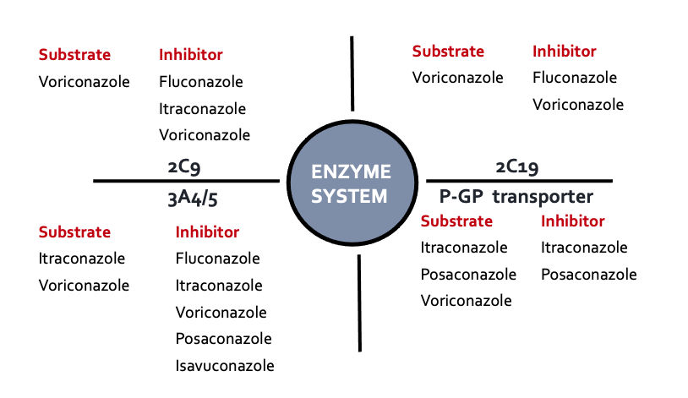
CYP450 Interactions: The achilles heel of triazoles
75-85% of patients receiving mold-active triazoles have serious drug interactions

Slide 27
(R. J. M. Brüggemann et al. 2009; Andes et al. 2016)

Slide 28
PK/PD Properties of Small Molecule Kinase Inhibitors
Drug | Venetoclax | Midostraurin | Gilteritinib | Ivosidenib | Enasidinib | Glasdegib
Specificity (targets) | BCL2 | FLT3 | FLT3 | IDH1 | IDH2 | Hedgehog pathway
Hepatic | CYP3A4 | CYP3A4 | CYP3A4/5 | CYP3A4/5 | Multiple CYP enzymes including CYP3A4 | CYP3A4/5
Efflux | Substrate of PgP, BCRP | Not a substrate | Substrate of PgP, not BCRP, OATP | Substrate PgP, but not BRCP | Not a substrate of BCRP pr PgP | Substrate for PGP, BCRP

Slide 29
(Megías-Vericat et al. 2020)

Slide 30
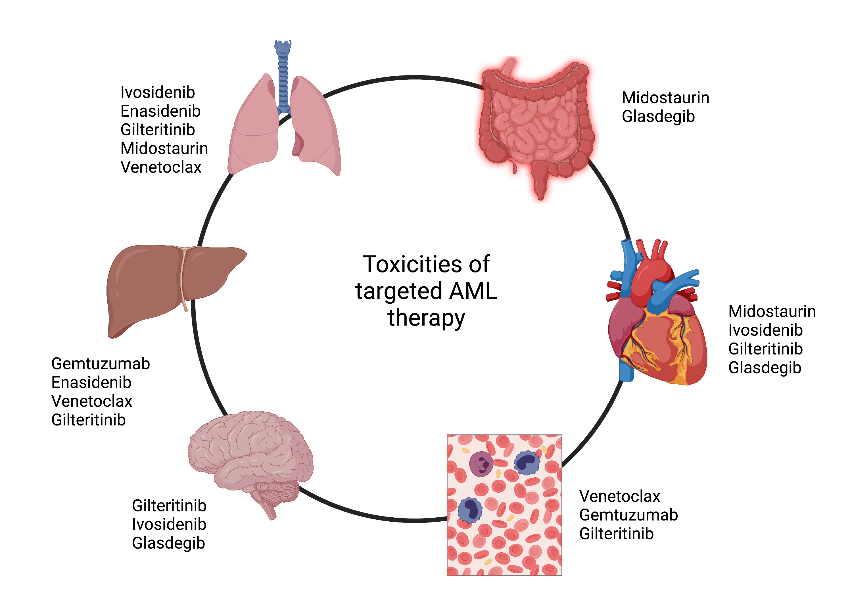
Toxicities of small-molecule kinase inhibitors

Slide 31
(Wang and Baron 2020)

Slide 32
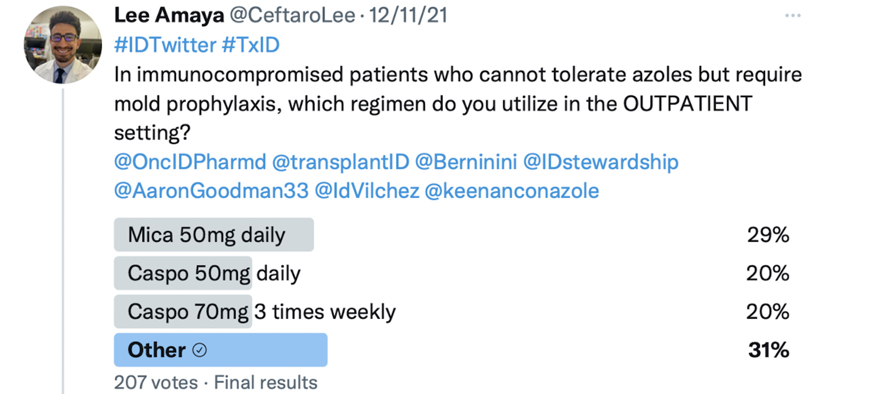
Just avoid triazoles?

Slide 33
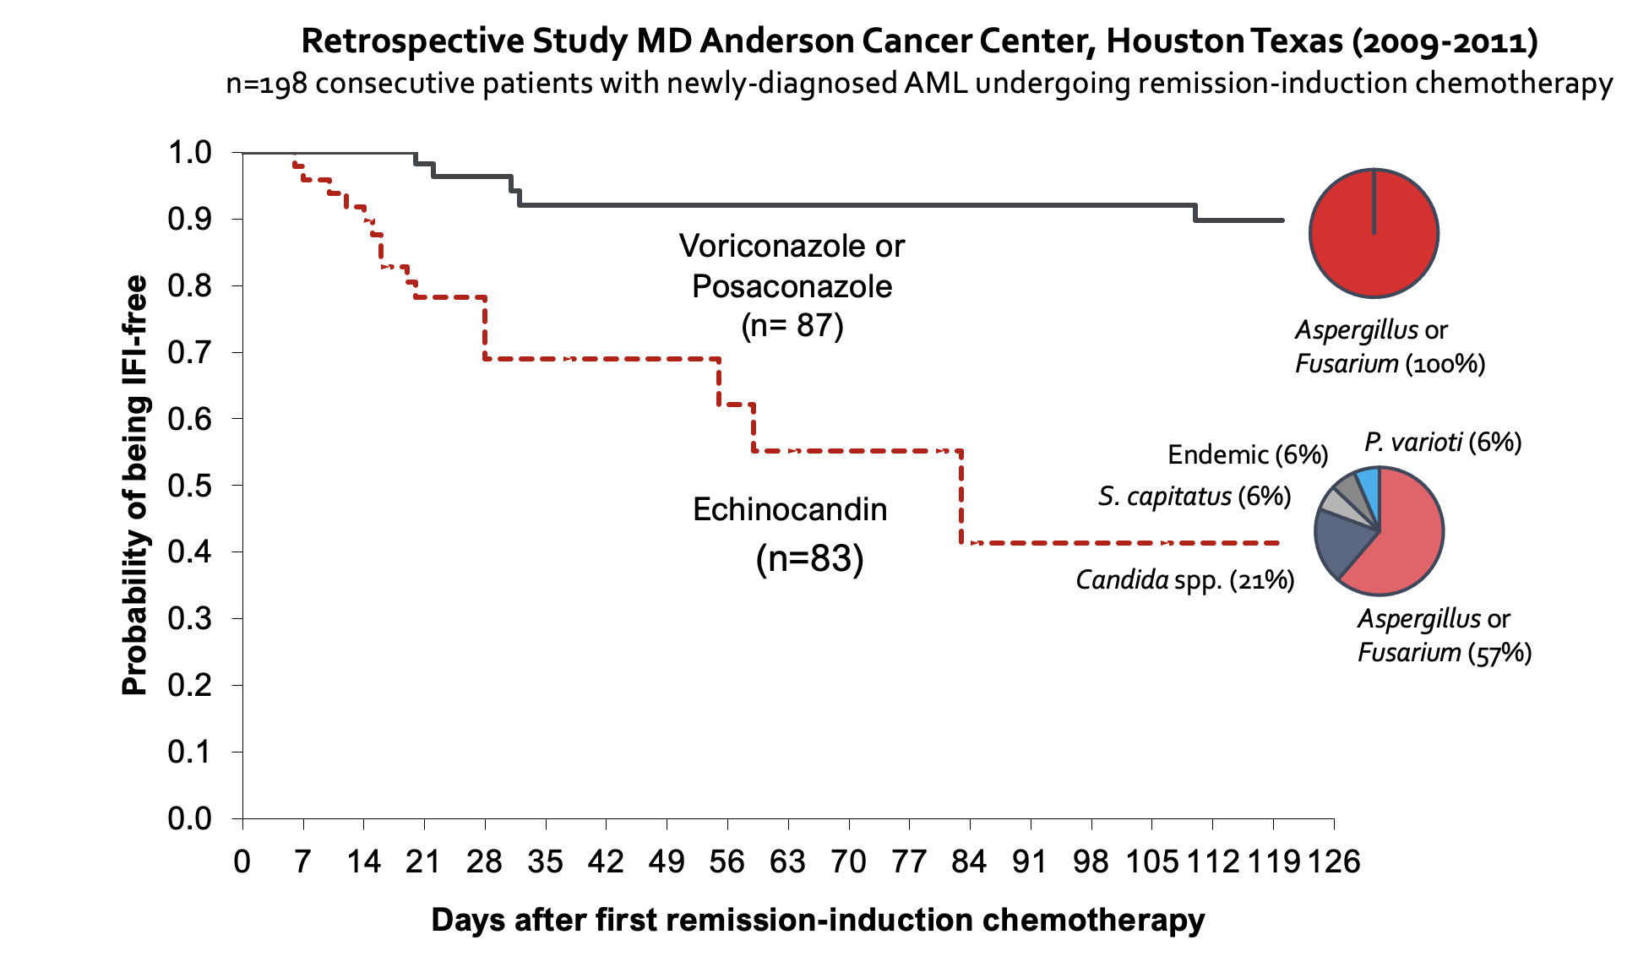
The problems with echinocandin prophylaxis

Slide 34
(Gomes et al. 2014)

Slide 35
Is their a unique role for isavuconazole vs. other triazoles?

Slide 36
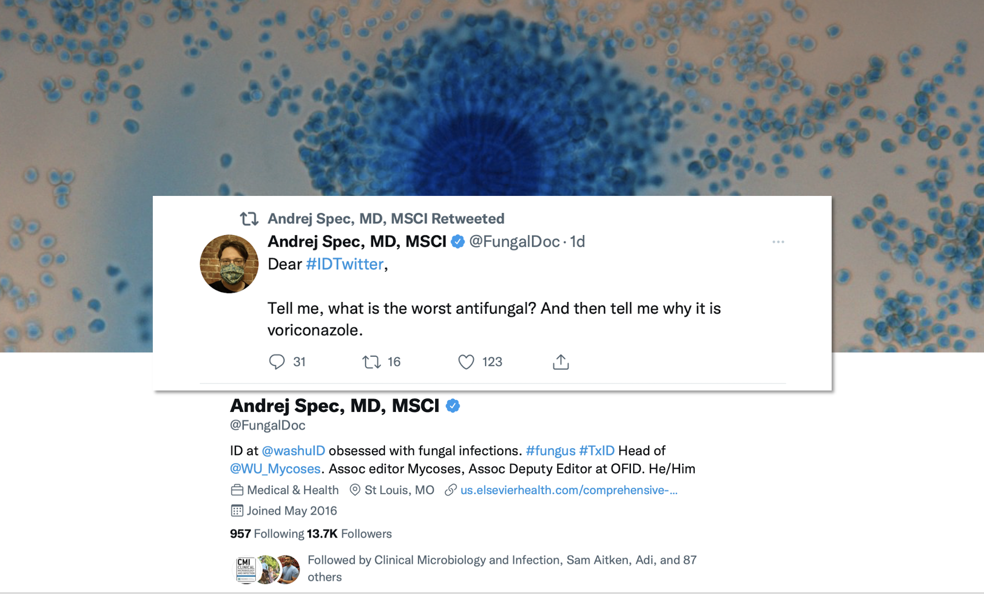

Slide 37
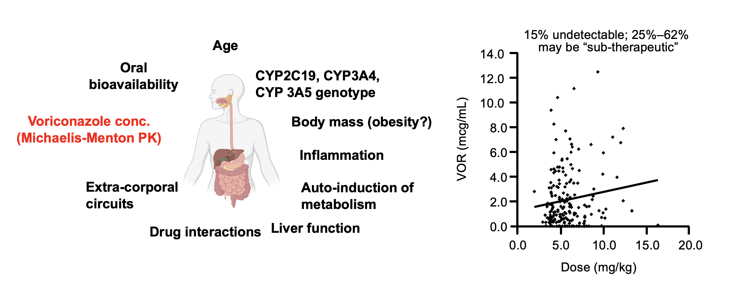
Pharmacokinetic complexity of voriconazole

Slide 38
(Trifilio and Mehta 2014)

Slide 39
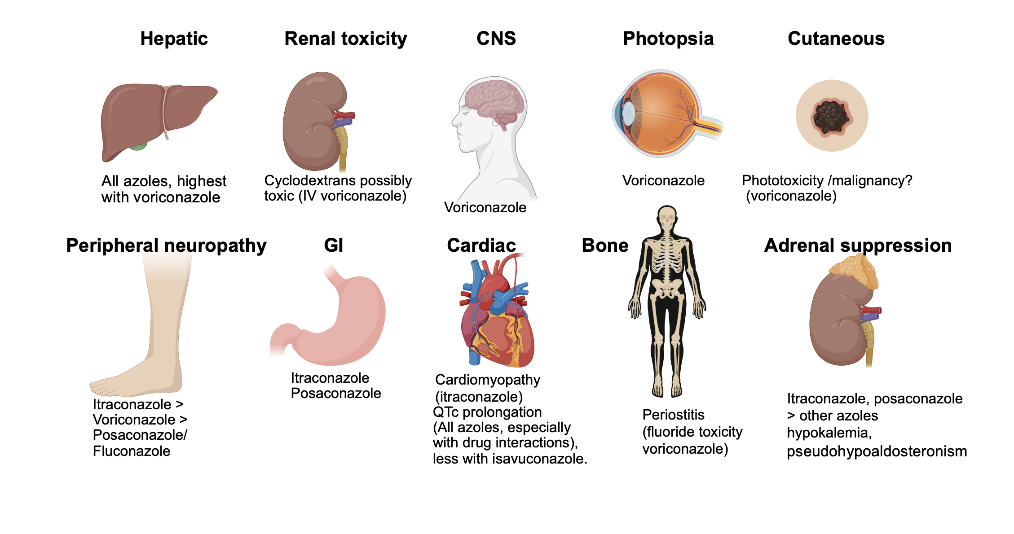
Triazole toxicities

Slide 40
(Lewis 2011; Johnson 2021)

Slide 41
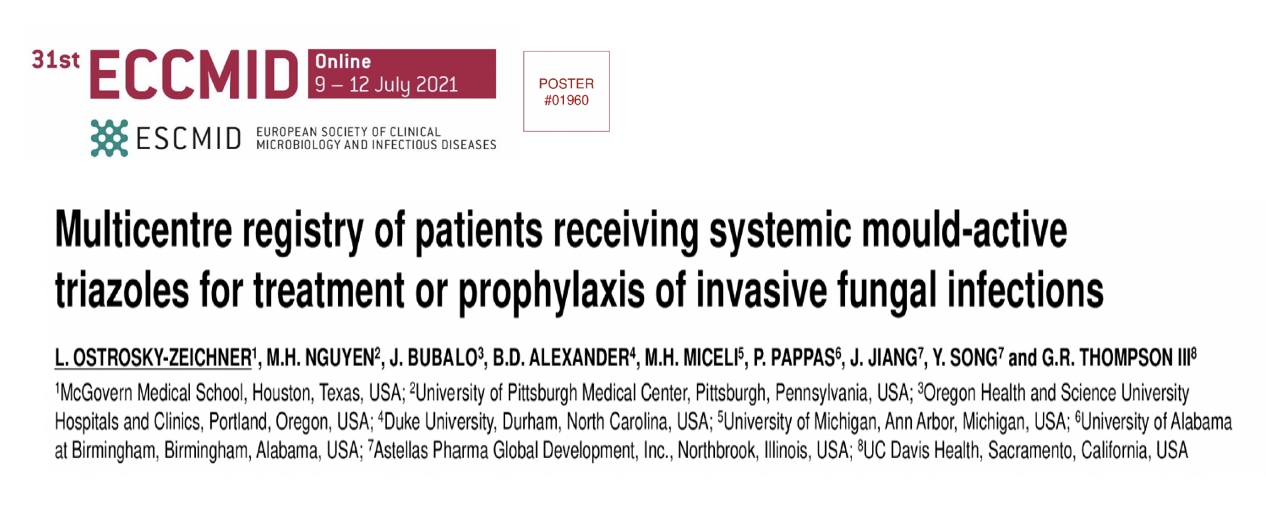

Slide 42
(ostroskey-zeichnerluis2021J?)

Slide 43
Triazole safety
Multicenter registry of prophylaxis (n=1777) and treatment (n=816) courses
Adverse effects leading to treatment discontinuation:
voriconazole (n=494) 14.2%
posaconazole (n=547) 11.3%
isavuconazole (n=514) 3.9%
multiple/sequenced therapy (n=454) 11.7%
QTc prolongation was rare, but more frequent with voriconazole and posaconazole
Severe drug interactions occurred in 4% of all treated patients
IFI mortality rates were similar for all agents ranging between 1.1-1.8%
(Ostroskey-Zeichner, L et al. 2021)

Slide 44
What makes isavuconazole (isavuconazonium) unique?
Broad spectrum of activity
Prodrug IV/ oral formulations (> 90% bioav.)
Predictable linear PK, t_{1/2}=130h
Less need for TDM
Better safety profile than voriconazole
Less potent CYP3A4/5 inhibition
Less cutaneous, CNS, hepatic toxicities
Does not prolong QT

Slide 45
(Johnson 2021; Maertens et al. 2016)

Slide 46
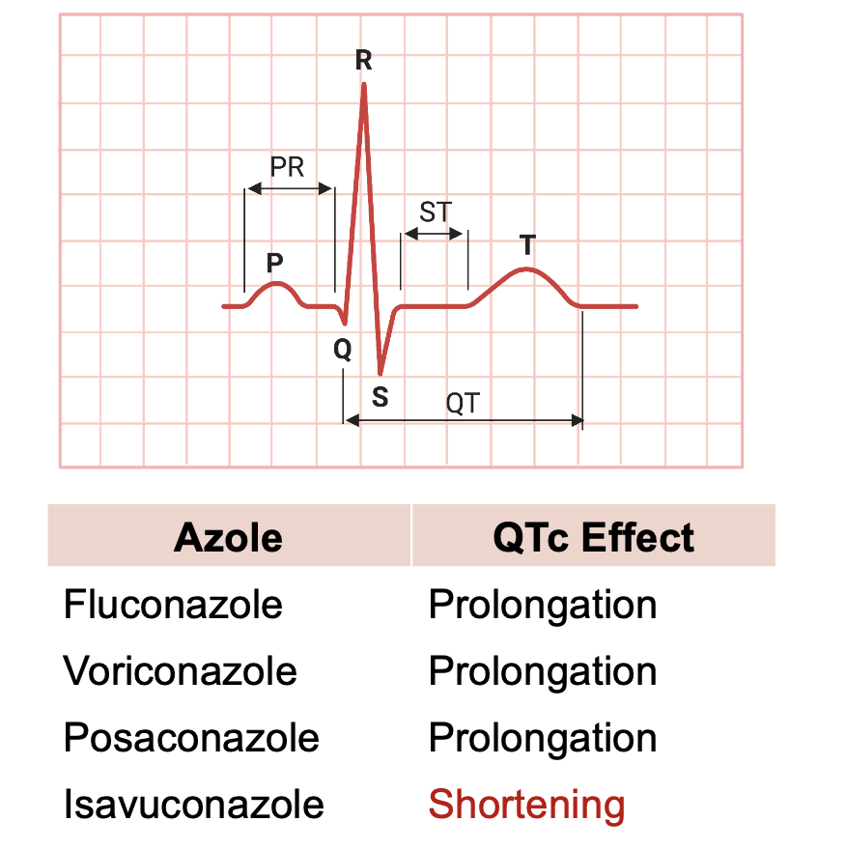
QT prolongation risk with triazoles
Older triazoles inhibit human ether-a-go-go (hERG) channel, which underlies rapid K⁺ rectifier current
Isavuconazole shortens cardia QT in a dose-related manner, with no associated cardiac risk
hCav1.2 L-type Ca⁺⁺ channels

Slide 47
(Keirns et al. 2017)

Slide 48
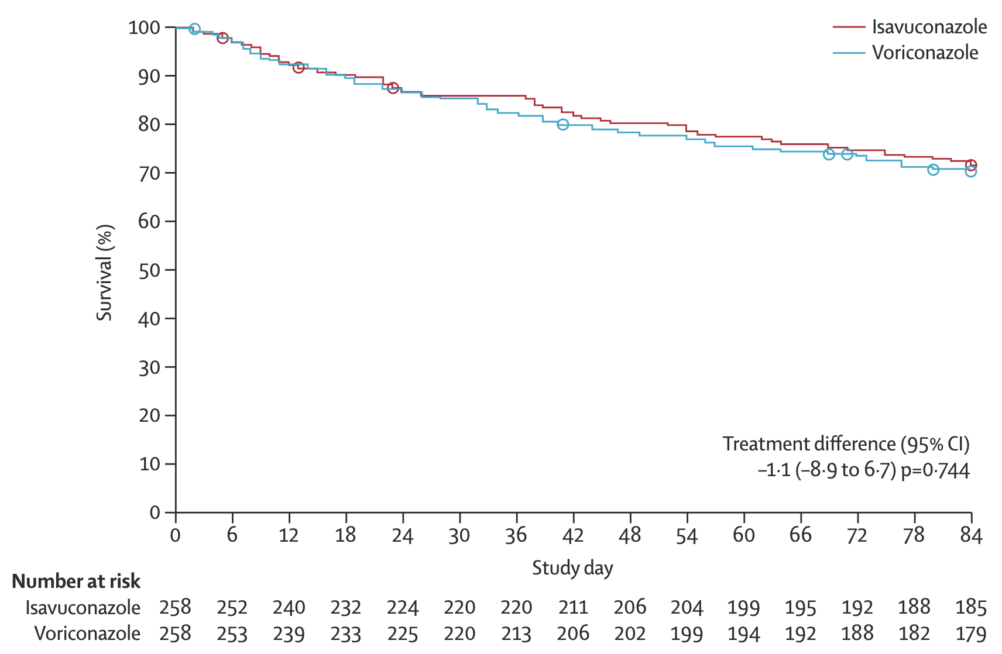
Isavuconazole versus voriconazole for primary treatment of invasive mould disease caused by Aspergillus and other filamentous fungi (SECURE)

Slide 49
(Maertens et al. 2016)

Slide 50
Treatment-emergent adverse effects in the SECURE trial
Hepatobiliary disorders (VOR-16% vs. ISA-9%, p=0.016)
Visual disturbances (VOR-27% vs. ISA-15%, p=0.002)
Skin or subcutaneous tissue (VOR-42% vs. ISA-33%, p=0.037
Overall drug-related AE (VOR-60% vs. ISA-42%, p<0.001)
(Maertens et al. 2016)

Slide 51
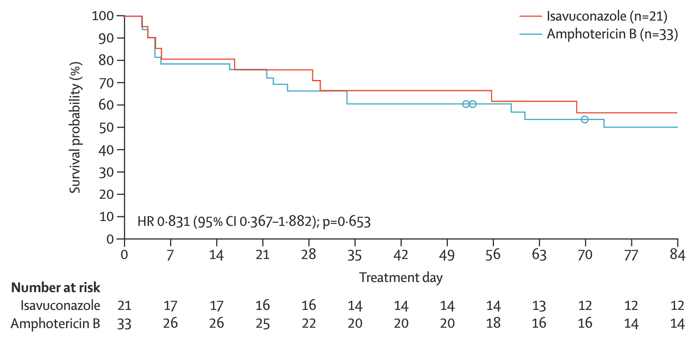
Isavuconazole treatment for mucormycosis: a single-arm, open-label, case-control study (VITAL)

Slide 52
(Marty et al. 2014)

Slide 53
Isavuconazole drug interaction potential
Drug | Pharmacokinetic change | Initial management
Tacrolimus | ↑ AUC 1.8-3xfold ↑ C_{max} 1.4-2.8xfold | 40-50% reduction in tacrolimus dose, TDM. Some studies suggest no empiric dose reduction was required
Prednisone/ Prednislone | ↑ AUC (8%) minimal | No dose adjustments recommended
Ruxolitinib | ↑AUC and C_{max} by an average of 27% and 8% | Although dose reduction is recommended for strong CYP3A4 inhibitors, no dose reduction recommended with isavuconazole

Slide 54
[Kufel et al. (2018);Kieu et al. (2019); Groll et al. (2017); Ouatas et al. (2017);]

Slide 55
Isavuconazole drug interaction potential
Drug | Pharmacokinetic change | Initial management
Venetoclax | ↑AUC 2-3.9xfold | Dose reduction of venetoclax by 50%
Midostaurin | ↑AUC 1.44xfold higher | No dose reduction recommended for moderate CYP3A4 inhibitors
Gilteritinib | ↑AUC 1.4xfold; ↑C_{max} 1.2-fold higher | No dose reduction recommended for moderate CYP3A4 inhibitors

Slide 56
(Kufel et al. 2018; Kieu et al. 2019; Groll et al. 2017; Ouatas et al. 2017)

Slide 57
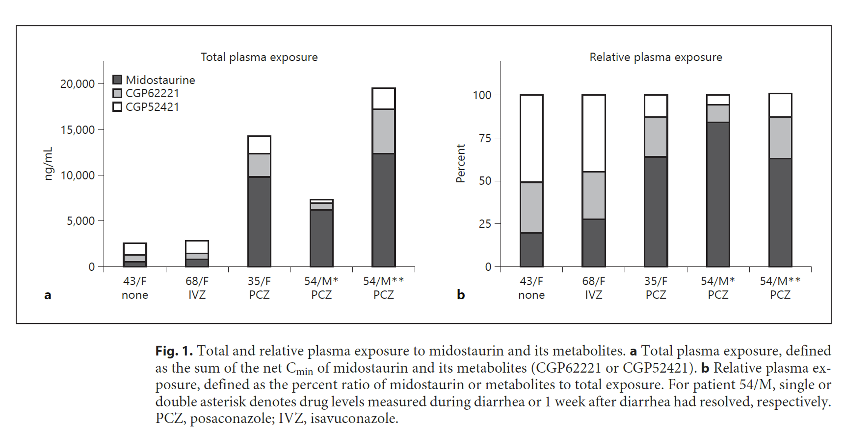
Are the theoretical differences clinically important?

Slide 58
(Menna et al. 2021)

Slide 59
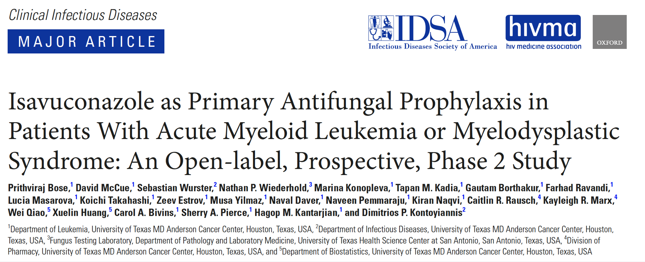

Slide 60
(Bose et al. 2020)

Slide 61
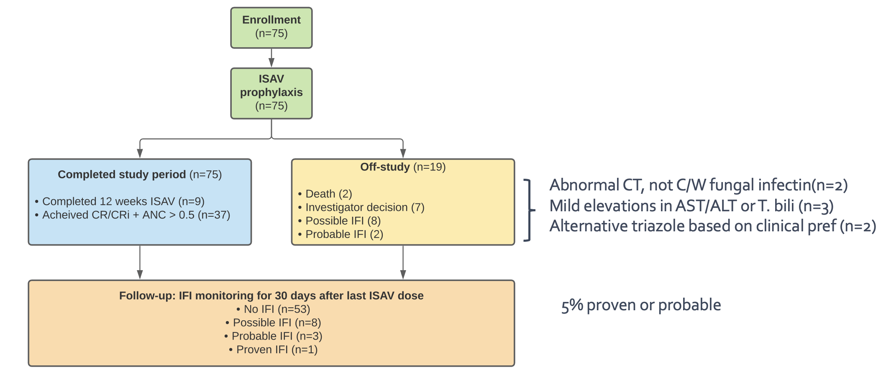

Slide 62
(Bose et al. 2020)

Slide 63
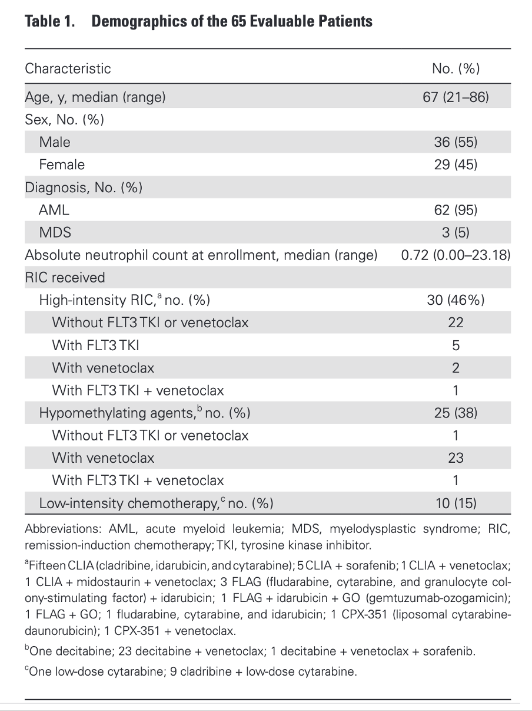

Slide 64
(Bose et al. 2020)

Slide 65
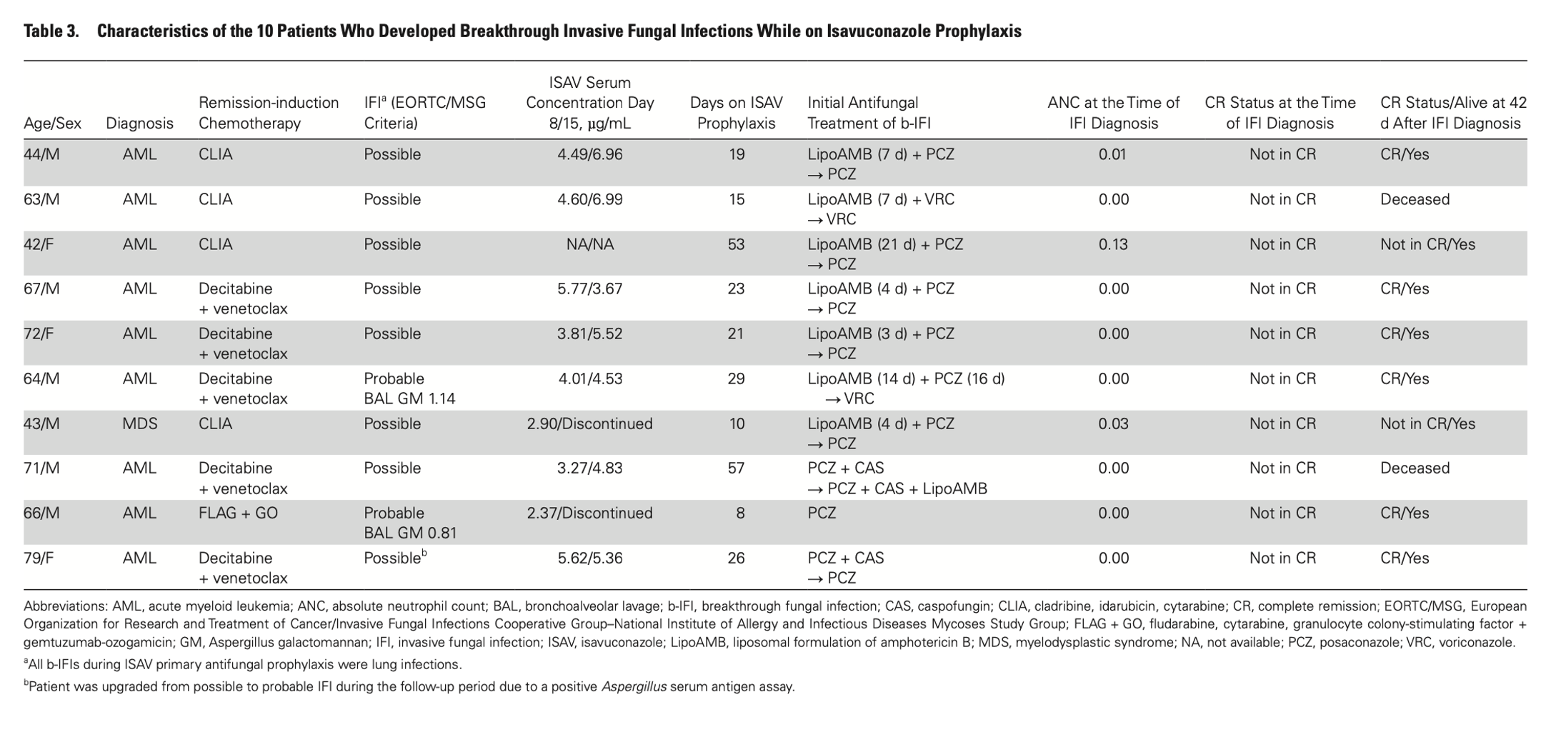

Slide 66
(Bose et al. 2020)

Slide 67
Isavuconazole tolerability

Slide 68
Posaconazole experience
Grade III/IV liver injury with tablet and IV formulations (9%)
Primary hyperbilirubinemia
Higher frequency in patients with serum levels > 1,830 ng/mL
Isavuconazole (current study)
Grade 1 transaminitis (2.7%)
Grade 2 elevated T. bilirubin (1.3%)
No elevations in QTc detected vs. baselines at 10 days

Slide 69
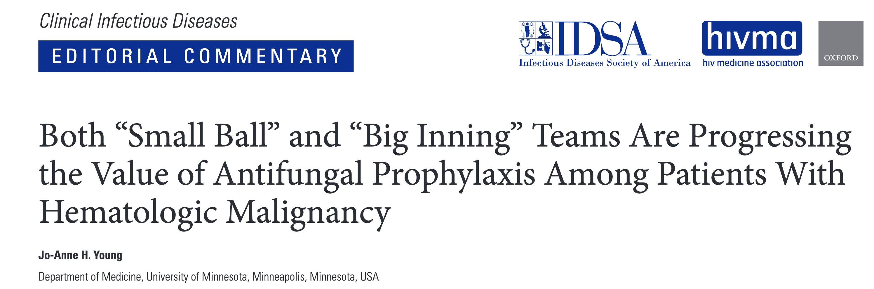

Slide 70
(Young 2021)

Slide 71
Jo-Anne H. Young, Clin Infect Dis 2021
“This is the first antifungal prophylaxis study in this select population of patients with leukemia, specifically, those patients being treated with the BCL-2 antagonist venetoclax and fms3-like tyrosine kinase 3 (FLT3) inhibitors.
“Clinicians should take away from these studies the fact that many of the advanced-generation azoles can be used interchangeably in times of prophylaxis when they are needed.”

Slide 72
Summary
Knowledge of fungal infection risk with targeted therapy is evolving, and depends heavily on the treatment scenario
Many small molecule inhibitors are metabolised by CYP3A4/5 and have potential for QTc prolongation, making concurrent use with broad-spectrum triazoles difficult
Isavuconazole has several unique pharmacokinetic and safety advantages over older triazoles, making it an useful alternative in patients receiving targeted therapies

Slide 73
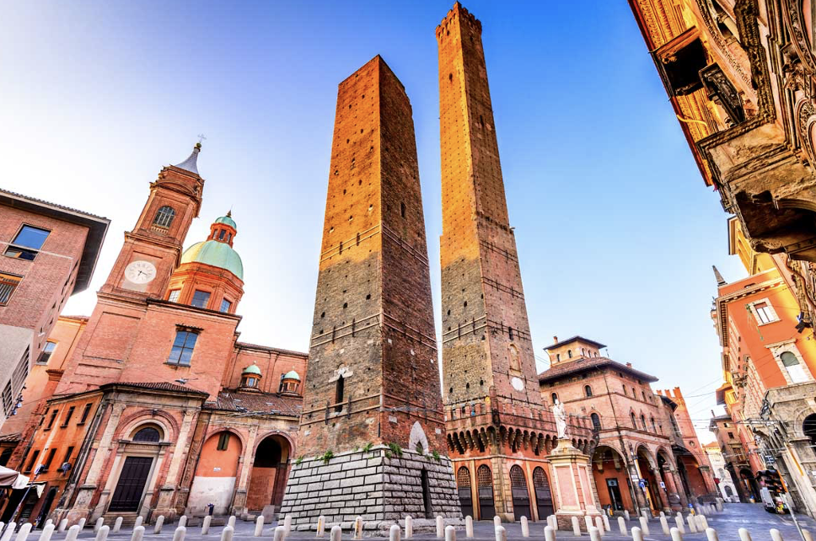
Thank you for your attention!

Slide 74


Slide 75


Slide 76
References
All figures created by R. Lewis using www.biorender.com
Andes, David, Nkechi Azie, Hongbo Yang, Rachel Harrington, Caroline Kelley, Ruo-Ding Tan, Eric Q Wu, et al. 2016. “Drug-Drug Interaction Associated with Mold-Active Triazoles Among Hospitalized Patients.” Antimicrobial Agents and Chemotherapy 60 (6): 3398–3406. https://doi.org/10.1128/AAC.00054-16.
Bhatnagar, Sumit, Dwaipayan Mukherjee, Ahmed Hamed Salem, Dale Miles, Rajeev M. Menon, and John P. Gibbs. 2021. “Dose Adjustment of Venetoclax When Co-Administered with Posaconazole: Clinical Drug-Drug Interaction Predictions Using a PBPK Approach.” Cancer Chemotherapy and Pharmacology 87 (4): 465–74. https://doi.org/10.1007/s00280-020-04179-w.
Bose, Prithviraj, David McCue, Sebastian Wurster, Nathan P Wiederhold, Marina Konopleva, Tapan M Kadia, Gautam Borthakur, et al. 2020. “Isavuconazole as Primary Anti-Fungal Prophylaxis in Patients with Acute Myeloid Leukemia or Myelodysplastic Syndrome: An Open-Label, Prospective, Phase II Study.” Clinical Infectious Diseases: An Official Publication of the Infectious Diseases Society of America, April. https://doi.org/10.1093/cid/ciaa358.
Brüggemann, Roger J. M., Jan-Willem C. Alffenaar, Nicole M. A. Blijlevens, Eliane M. Billaud, Jos G. W. Kosterink, Paul E. Verweij, David M. Burger, and Louis D. Saravolatz. 2009. “Clinical Relevance of the Pharmacokinetic Interactions of Azole Antifungal Drugs with Other Coadministered Agents.” Clinical Infectious Diseases 48 (10): 1441–58. https://doi.org/10.1086/598327.
Brüggemann, Roger J, Rebecca Verheggen, Emmy Boerrigter, Marta Stanzani, Paul E Verweij, Nicole M A Blijlevens, and Russell E Lewis. 2022. “Management of Drugdrug Interactions of Targeted Therapies for Haematological Malignancies and Triazole Antifungal Drugs.” The Lancet Haematology 9 (1): e58–72. https://doi.org/10.1016/S2352-3026(21)00232-5.
Burger, Jan A, Alessandra Tedeschi, Paul M Barr, Tadeusz Robak, Carolyn Owen, Paolo Ghia, Osnat Bairey, et al. 2015. “Ibrutinib as Initial Therapy for Patients with Chronic Lymphocytic Leukemia.” The New England Journal of Medicine 373 (25): 2425–37. https://doi.org/10.1056/NEJMoa1509388.
Chamilos, Georgios, Michail S Lionakis, and Dimitrios P Kontoyiannis. 2018. “Call for Action: Invasive Fungal Infections Associated With Ibrutinib and Other Small Molecule Kinase Inhibitors Targeting Immune Signaling Pathways.” Clinical Infectious Diseases: An Official Publication of the Infectious Diseases Society of America 66 (1): 140–48. https://doi.org/10.1093/cid/cix687.
Frei, Michael, Samuel L. Aitken, Nitin Jain, Philip Thompson, William Wierda, Dimitrios P. Kontoyiannis, and Adam J. DiPippo. 2020. “Incidence and Characterization of Fungal Infections in Chronic Lymphocytic Leukemia Patients Receiving Ibrutinib.” Leukemia & Lymphoma 61 (10): 2488–91. https://doi.org/10.1080/10428194.2020.1775215.
Ghez, David, Anne Calleja, Caroline Protin, Marine Baron, Marie-Pierre Ledoux, Gandhi Damaj, Mathieu Dupont, et al. 2018. “Early-Onset Invasive Aspergillosis and Other Fungal Infections in Patients Treated with Ibrutinib.” Blood 131 (17): 1955–59. https://doi.org/10.1182/blood-2017-11-818286.
Gomes, Marisa Z R, Ying Jiang, Victor E Mulanovich, Russell E Lewis, and Dimitrios P Kontoyiannis. 2014. “Effectiveness of Primary Anti-Aspergillus Prophylaxis During Remission Induction Chemotherapy of Acute Myeloid Leukemia.” Antimicrobial Agents and Chemotherapy 58 (5): 2775–80. https://doi.org/10.1128/AAC.01527-13.
Groll, A H, A Desai, D Han, C Howieson… - … in drug development, and 2017. 2017. “Pharmacokinetic Assessment of Drug-Drug Interactions of Isavuconazole with the Immunosuppressants Cyclosporine, Mycophenolic Acid, Prednisolone ….” Wiley Online Library.
Johnson, Melissa D. 2021. “Antifungals in Clinical Use and the Pipeline.” Infectious Disease Clinics of North America, Fungal Infections, 35 (2): 341–71. https://doi.org/10.1016/j.idc.2021.03.005.
Kantarjian, Hagop M., Nitin Jain, Guillermo Garcia-Manero, Mary Alma Welch, Farhad Ravandi, William G. Wierda, and Elias J. Jabbour. 2022. “The Cure of Leukemia Through the Optimist’s Prism.” Cancer 128 (2): 240–59. https://doi.org/10.1002/cncr.33933.
Kantarjian, Hagop, Nicholas J Short, Courtney DiNardo, Eytan M Stein, Naval Daver, Alexander E Perl, Eunice S Wang, Andrew Wei, and Martin Tallman. 2021. “Harnessing the Benefits of Available Targeted Therapies in Acute Myeloid Leukaemia.” The Lancet Haematology 8 (12): e922–33. https://doi.org/10.1016/S2352-3026(21)00270-2.
Keirns, J, A Desai, D Kowalski, C Lademacher, S Mujais, B Parker, M J Schneidkraut, et al. 2017. “QT Interval Shortening With Isavuconazole: In Vitro and In Vivo Effects on Cardiac Repolarization.” Clinical Pharmacology and Therapeutics 101 (6): 782–90. https://doi.org/10.1002/cpt.620.
Kieu, Van, Kristi Jhangiani, Sanjeet Dadwal, Ryotaro Nakamura, and Doreen Pon. 2019. “Effect of Isavuconazole on Tacrolimus and Sirolimus Serum Concentrations in Allogeneic Hematopoietic Stem Cell Transplant Patients: A Drug-Drug Interaction Study.” Transplant Infectious Disease: An Official Journal of the Transplantation Society 21 (1): e13007. https://doi.org/10.1111/tid.13007.
Kufel, Wesley D, Paul M Armistead, Lindsay M Daniels, Jonathan R Ptachcinski, Maurice D Alexander, and J Ryan Shaw. 2018. “Drug-Drug Interaction Between Isavuconazole and Tacrolimus: Is Empiric Dose Adjustment Necessary?” Journal of Pharmacy Practice, July, 897190018790688. https://doi.org/10.1177/0897190018790688.
Lewis, R. E. 2011. “Current Concepts in Antifungal Pharmacology.” Mayo Clinic Proceedings 86 (8): 805–17. https://doi.org/10.4065/mcp.2011.0247.
Maertens, Johan A, Issam I Raad, Kieren A Marr, Thomas F Patterson, Dimitrios P Kontoyiannis, Oliver A Cornely, Eric J Bow, et al. 2016. “Isavuconazole Versus Voriconazole for Primary Treatment of Invasive Mould Disease Caused by Aspergillus and Other Filamentous Fungi (SECURE): A Phase 3, Randomised-Controlled, Non-Inferiority Trial.” The Lancet 387 (10020): 760–69. https://doi.org/10.1016/S0140-6736(15)01159-9.
Marty, Francisco M, John R Perfect, Oliver A Cornely, Kathleen Mullane, Galia Rahav, Misun Lee, Masanori Ito, Rochelle Maher, Bernhardt Zeiher, and Luis Ostrosky-Zeichner. 2014. “An Open-Label Phase 3 Study of Isavuconazole (VITAL): Focus on Mucormycosis.” Risk 8: 21–26.
Megías-Vericat, Juan Eduardo, Antonio Solana-Altabella, Octavio Ballesta-López, David Martínez-Cuadrón, and Pau Montesinos. 2020. “Drug-Drug Interactions of Newly Approved Small Molecule Inhibitors for Acute Myeloid Leukemia.” Annals of Hematology 99 (9): 1989–2007. https://doi.org/10.1007/s00277-020-04186-0.
Menna, Pierantonio, Emanuela Salvatorelli, Maria Ilaria Del Principe, Salvatore Perrone, Livio Pagano, Francesco Marchesi, and Giorgio Minotti. 2021. “Choosing Antifungals for the Midostaurin-Treated Patient: Does Cyp3a4 Outweigh Recommendations? A Brief Insight from Real Life.” Chemotherapy 66 (1-2): 47–52. https://doi.org/10.1159/000513989.
Ostroskey-Zeichner, L, MH Nguyen, Bubalo, J., Alexander, B.J., M. H. Miceli, P. Pappas, Song, Y, and Thompson, G.R. 2021. “Multicenter Registry of Patients Recieving Systemic Mould-Active Triazoles for Treatment or Prophylaxis of Fungal Infections.” In 31st European Conference on Clinical Microbiology and Infectious Diseases. Online.
Ouatas, Taoufik, Vincent Duval, Karen Sinclair, and Noah Berkowitz. 2017. “Concomitant Use of Midostaurin with Strong Cyp3a4 Inhibitors: An Analysis from the Ratify Trial.” Blood 130 (Supplement 1): 3814–14. https://doi.org/10.1182/blood.V130.Suppl_1.3814.3814.
Rausch, Caitlin R, Courtney D DiNardo, Abhishek Maiti, Nadya Jammal, Tapan M Kadia, Kayleigh Marx, Gautam M Borthakur, et al. 2019. “Venetoclax Dosing in Combination with Antifungal Agents: Real World Experience in Patients with Acute Myeloid Leukemia.” Blood 134 (Supplement_1): 2640–40. https://doi.org/10.1182/blood-2019-131988.
Stemler, Jannik, Nick de Jonge, Nicole Skoetz, János Sinkó, Roger J Brüggemann, Alessandro Busca, Ronen Ben-Ami, et al. 2022. “Antifungal Prophylaxis in Adult Patients with Acute Myeloid Leukaemia Treated with Novel Targeted Therapies: A Systematic Review and Expert Consensus Recommendation from the European Hematology Association.” The Lancet Haematology 9 (5): e361–73. https://doi.org/10.1016/S2352-3026(22)00073-4.
Trifilio, S, and J Mehta. 2014. “Antimicrobial Prophylaxis in Hematopoietic Stem Cell Transplantation Recipients: 10 Years After.” Transplant Infectious Disease: An Official Journal of the Transplantation Society 16 (4): 548–55. https://doi.org/10.1111/tid.12237.
Varughese, Tilly, Ying Taur, Nina Cohen, M Lia Palomba, Susan K Seo, Tobias M Hohl, and Gil Redelman-Sidi. 2018. “Serious Infections in Patients Receiving Ibrutinib for Treatment of Lymphoid Cancer.” Clinical Infectious Diseases: An Official Publication of the Infectious Diseases Society of America 67 (5): 687–92. https://doi.org/10.1093/cid/ciy175.
Wang, Eunice S, and Jeffrey Baron. 2020. “Management of Toxicities Associated with Targeted Therapies for Acute Myeloid Leukemia: When to Push Through and When to Stop.” Hematology / the Education Program of the American Society of Hematology. American Society of Hematology. Education Program 2020 (1): 57–66. https://doi.org/10.1182/hematology.2020000089.
Young, Jo-Anne H. 2021. “Both ‘Small Ball’ and ‘Big Inning’ Teams Are Progressing the Value of Antifungal Prophylaxis Among Patients with Hematologic Malignancy.” Clinical Infectious Diseases: An Official Publication of the Infectious Diseases Society of America 72 (10): 1764–66. https://doi.org/10.1093/cid/ciaa569.

Slide 77
Notes
1. fluconazole, isavuconazole
2. voriconazole, posaconazole

